Slide 1
Thynk Unlimited
DESIGN AND SIMULATION OF A DIGITAL DATA TRANSMISSION ERROR DETECTIONL SYSTEM USING XOR LOGIC

Slide 2

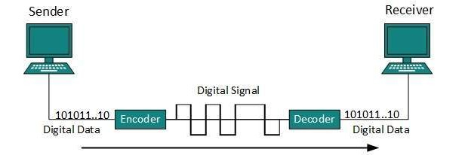
DIGITAL DATA TRANSMISSION
Data transmission is the transfer of data from one digital device to
channels. It powers the digital world by routing information across network
another through wired or wireless network
channels.
From
traditional
connectivity
copper-based hardware to contemporary
wireless
systems, these data
streams now travel across a global
wireless network to
ensure
precise
communication
between
interconnected devices.

Slide 3
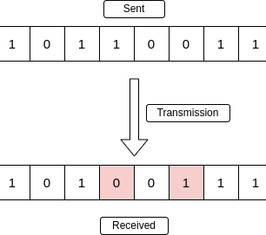



ERRORS IN DATA TRANSMISSION
Transmission errors and ways to detect
Transmission error refers to the loss of data integrity d ring data transit, ca sed by hardware fa lts or noise. Vario s methods like parity checking and checks ms are sed to detect and correct these errors to ens re acc rate data transmission.
Error Detection odes - Parity Bit
An error detection code is a method sed to detect errors d ring data transmission or storage of digital data.
Extra bits are added to the original data.
These bits allow the receiver to detect inconsistencies, indicating potential data errors

Slide 4
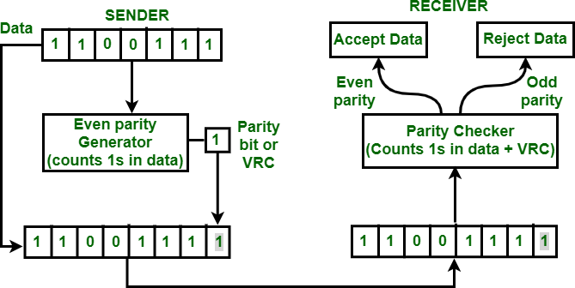
USE OF XOR GATES AND
PARITY IN ERROR DETECTION
-XOR gates generate a parity bit at the transmitter.
-The parity bit ensures that the total number of 1s is even or odd.
-At the receiver, XOR gates check all received bits, including the
parity bit.
-Output 0: no error detected.
-Output 1: an error is detected.
-Parity detects single-bit and other odd-number bit errors, but it cannot correct errors or detect
all even-number bit errors.

Slide 5
WORKING PRINCIPLE
XOR gates generate a parity bit at the transmitter.
The parity bit ensures that the total number of 1s is even or odd.
At the receiver, XOR gates check all received bits, including the parity bit.
Output 0: no error detected.
Output 1: an error is detected.
Parity detects single-bit and other odd-number bit errors, but it cannot correct errors or detect all even-number bit errors.
[4-Bit Data]
│
▼
[XOR Parity Generator]
│
▼
[Data + Parity Bit]
│
▼
[Transmission Channel]
│
▼
[XOR Parity Checker]
│
▼
[Error / No Error]

Slide 6
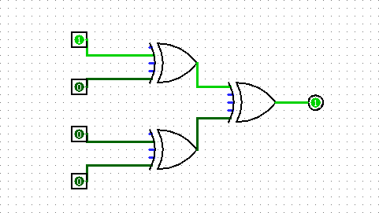
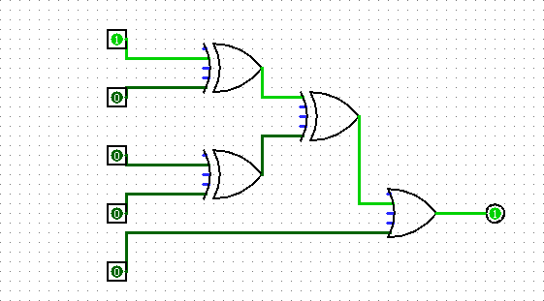
LOGISIM CIRCUIT DESIGN
PARITY GENERATOR
PARITY CHECKER
Parity generation: P=D3⊕D2⊕D1⊕D0 Checker output: 0 = No Error, 1 = Error Detected
XOR gates generate and verify parity to detect transmission errors.

Slide 7
ERROR
SIMULATION AND RESULTS
Simulation: To simulate a transmission
error, one data bit is changed after the
parity
altered
bit has
data and the
been generated. The
original parity bit
Data with One Changed Bit + Original Parity Bit
↓
XOR Parity Checker
↓
Output = 1 → Error Detected
are then applied to the XOR parity
checker.
Result: The XOR checker output becomes
1, showing that the received
data has
has been
incorrect parity and an error detected.
Conclusion: The simulation confirms that the circuit can detect a single-bit transmission error using XOR logic and parity checking.

Slide 8

APPLICATTION AND CONCLUSION
Applications
Used in computer networks for basic error detection. Applied in serial communication between digital devices. Used in memory systems to detect data corruption.
Helpful in embedded systems and digital circuit testing.
Provides a simple and low-cost method for detecting single-bit errors.
Conclusion
XOR gates provide an easy and efficient way to generate and check parity in digital data
transmission. detect single-bit
and other odd-number bit errors,
The system can
although it cannot correct errors or detect every even-number
bit error.
parity checking is suitable for simple applications, while CRC and other
Therefore,
advanced
techniques are preferred for more reliable communication.

Slide 9
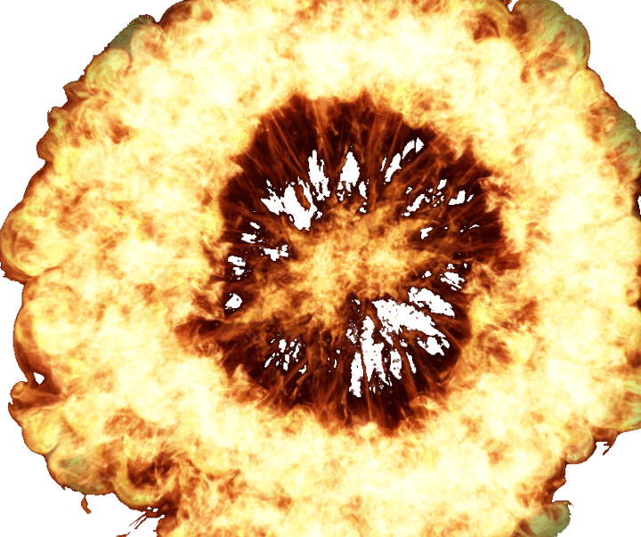
THANKYOU
...(*￣０ ￣)ノ

